Slide 1


AWS
FRESHERS PROGRAM

Slide 2

TECHNOLOGY
JAVA
PYTHON
SQL
AWS
AWS BASICS
LINUX BASICS
DEVOPS
APTITUDE
SOFT SKILLS

Slide 3

JAVA
Variables
Data type
Operators
Loop
Decision Making
OOPS(class, object, inheritance, Abstraction- abstract class and interface and Encapsulation)
Functional interface
Maker interface
Exception handling
File handling
Collections(list, set, queue )
Map
Recursion
JDBC
Servlet
Servlet mapping
Spring IOC
Spring MVC
Bean configuration
Spring Application flow

Slide 4

PYTHON
Introduction
Installation
Variables
Data Types
Print() / input()
Escape sequences
Type Casting
Operators
Collections - List/Tuple/Set/Dictionary
Function
Arbitrary Arguments
Python Standard Functions
Function Overloading
Recursive Function
Lambda Function
If Else
Loops
Error Handling
File Handling
Modules & Library
Interview Python Questions Solving

Slide 5

SQL
RDBMS
Installing DB Engine
SQL Syntax
Datatypes
DDL
DML
DCL
Keys
Queries
Subqueries
Joins
Views
Cursors

Slide 6

AWS BASICS
AWS Intro
EC2
S3
IAM
VPC
RDS

Slide 7

LINUX BASICS
Manage Files and Permission from the Command Line
Manage Local Users and Groups
Checking Server Performance
Scheduling Task
Manage storage and logs
Checking Firewall and network
Installing and upgrading Package

Slide 8
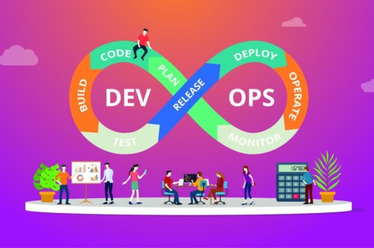
DEVOPS
GIT
Jenkins
CICD
Automated Application Deployments Includes Webserver & Appserver

Slide 9

APTITUDE
Quantitative Aptitude
Data Interpretation
Logical Reasoning

Slide 10

SOFT SKILLS
Placement guidance
Resume Makeover
Job searching techniques
Professional Etiquette
Communication development
Personal Counseling

Slide 11


